Slide 1
QUIZZIFY - A DISCORD BOT
Lambda 3.0 Assignment presentation
Sourabh Bera (berasourabh2071@gmail.com)

Slide 2
Technologies used
Technologies :
Mongodb
Node Js
Package manager:
Yarn
Libraries used :
Discord Js
Mongoose

Slide 3
Features
Time-Limited Questions
Streak Rewards: Earn bonuses for consecutive correct answers.
Randomized questions: All the questions will not be same for different used
Dynamic Difficulty Levels: The bot adjusts question difficulty based on participants' performance.
Leaderboard Access: Track top scores and compete for a spot on the server's leaderboard,
Admin Features: Server administrators can add, remove, or modify questions.
Privacy : Your questions will not be visible to others. This ensured an healthy competition

Slide 4
Rules for the game
Scoring, Time Limits, and Difficulty Dynamics:
Easy Questions(True/False): Secure 3 points within 5 seconds, or settle for 2 points for responses within 15 seconds.
Medium Questions(MCQ): Gain 7 points if answered within 10 seconds, or 5 points for answers up to 30 seconds.
Hard Questions(Textual): Earn 13 points for responses within 15 seconds, or 10 points for those up to 30 seconds.
Advancement and Setbacks:
Ascend in Difficulty: Two consecutive correct answers at your current difficulty level elevate you to the next tier.
The Penalty for Errors: A single incorrect answer will demote you to the previous difficulty level.
Bonus for Brilliance: In the Hard difficulty, a streak of two or more correct answers garners extra 5 points from the 3rd correct problem onwards.

Slide 5

How to start the quiz
Enter /quiz in any channel
This will create a channel which will be accessible only for you.

Slide 6
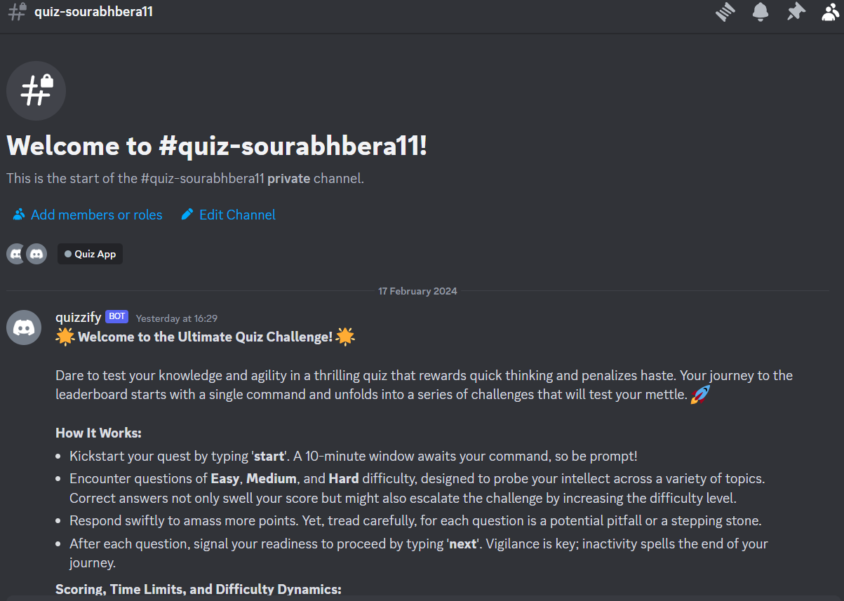
Go to the channel start the quiz
You will have 10 minutes to read out the rules. Enter start to start the quiz. If you dont start the quiz the quiz will expire You need to create a new quiz then.

Slide 7
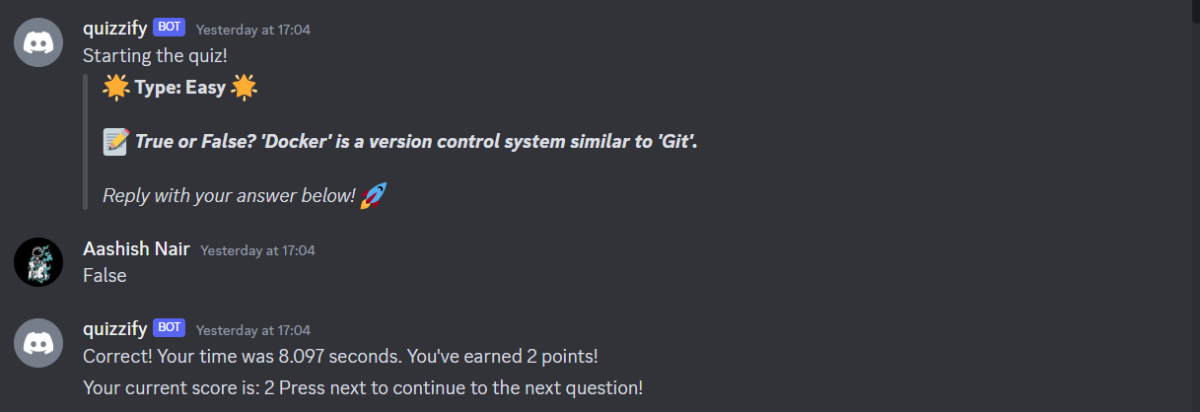
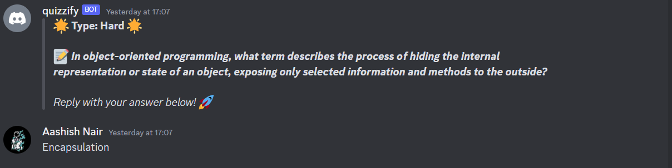
Tackling easy & hard questions
Reply with true or false for the easy type questions
Make sure you dont misspell it
The bot is not case sensitive
Reply with one or two words for the hard type questions
Make sure you don't misspell it
The bot is not case sensitive

Slide 8
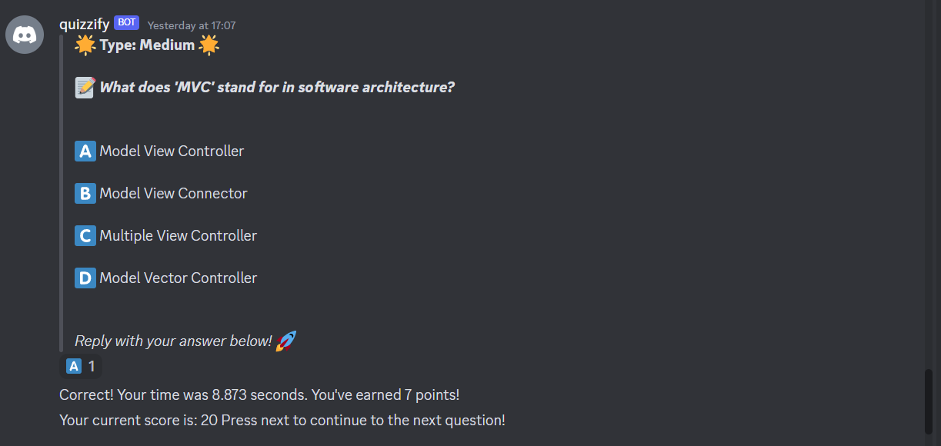
Tackling Medium Questions
You need to react to the message with appropriate emoji. To select the answer

Slide 9
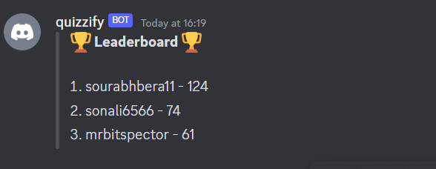
Leaderboard Access
Enter !leaderboard to see the leaderboard

Slide 10
Admin options
You must have access to admins channel get access to admin commands.
Use !add to add a problem to the pool
Use !view to view all the problems in the pool
Use !remove to remove a problem from the pool
User !edit to edit a problem

Slide 11
Thank You!
Source code:https://github.com/berasourabh11/Discord-Bot-Quiz-App
Video Presentation:

